Slide 1

Freedom, Prosperity & Innovation
A Brief History of Capitalism
J. William G. Chettle
Director of Experience and Engagement
Symmetry Partners, LLC
Symmetry Partners, LLC, is an investment advisory firm registered with the Securities and Exchange Commission. The firm only transacts business in states where it is properly registered or excluded or exempted from registration requirements. No one should assume that future performance of any specific investment, investment strategy, product, or non-investment related content referred to directly or indirectly in this material will be profitable. As with any investment strategy, there is a possibility of profitability as well as loss. All data is from sources believed to be reliable but cannot be guaranteed or warranted. For additional information regarding Symmetry Partners, LLC please see disclosure at the end of this presentation labeled Important Information. Symmetry Partners is not affiliated with any firm mentioned in this material.

Slide 2
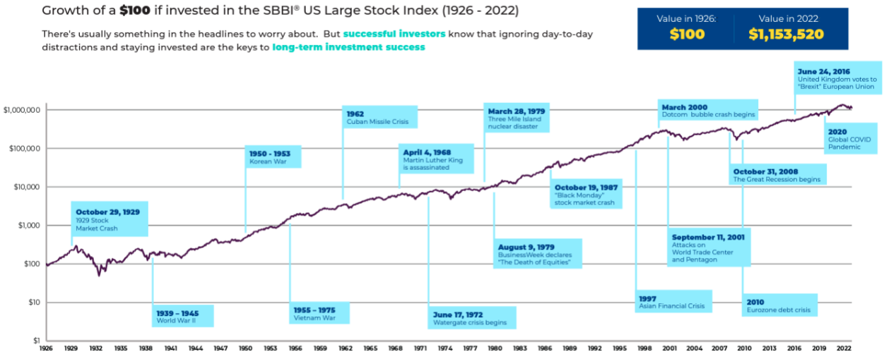
Markets Have Rewarded Discipline
SC: LC06
Investment Principles
Market Declines and Volatility US
Source: Morningstar 2022 All rights reserved. The information contained herein: (1) is proprietary to Morningstar and/or its content providers; (2) may not be copied, adapted or distributed; and (3) is not warranted to be Source: Morningstar 2023. All rights reserved. The information contained herein: (1) is proprietary to Morningstar and/or its content providers; (2) may not be copied, adapted or distributed; and (3) is not warranted to be accurate, complete or timely. Neither Morningstar nor its content providers are responsible for any damages or losses arising from any use of this information, except where such damages or losses cannot be limited or excluded by law in your jurisdiction. by Morningstar. the deduction of an investment management fee. Actual performance for client accounts will differ from index performance.
Notes:
Talking Points:
News and financial commentary can influence people’s view of investing. Without a strong investment philosophy to guide them, people also may follow the advice of friends, neighbors, or family, especially if the “insight” promises a fast, easy return.
But growing wealth has no shortcuts. Success requires a solid investment approach, a long-term perspective, and discipline to stay the course.

Slide 3

Notes:
We’re here to talk today about one of the greatest epics in the history of mankind: capitalism.

Slide 4

cap·i·tal·ism
noun \ˈka-pə-tə-ˌliz-əm,
Economic system characterized by private or corporate ownership of capital goods, by investments that are determined by private decision, and by prices, production, and the distribution of goods that are determined mainly by competition in a free market
Notes:
So what is the definition of capitalism?
[read slide]
But I prefer Milton Friedman’s definition: “The most important single central fact about a free market is that no exchange takes place unless both parties benefit.”

Slide 5
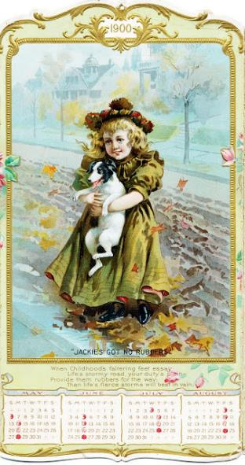
Notes:
It is 1900

Slide 6
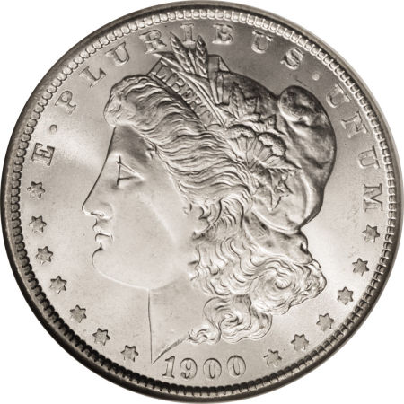
Notes:
If you had a dollar, a morgan silver dollar to invest anywhere

Slide 7
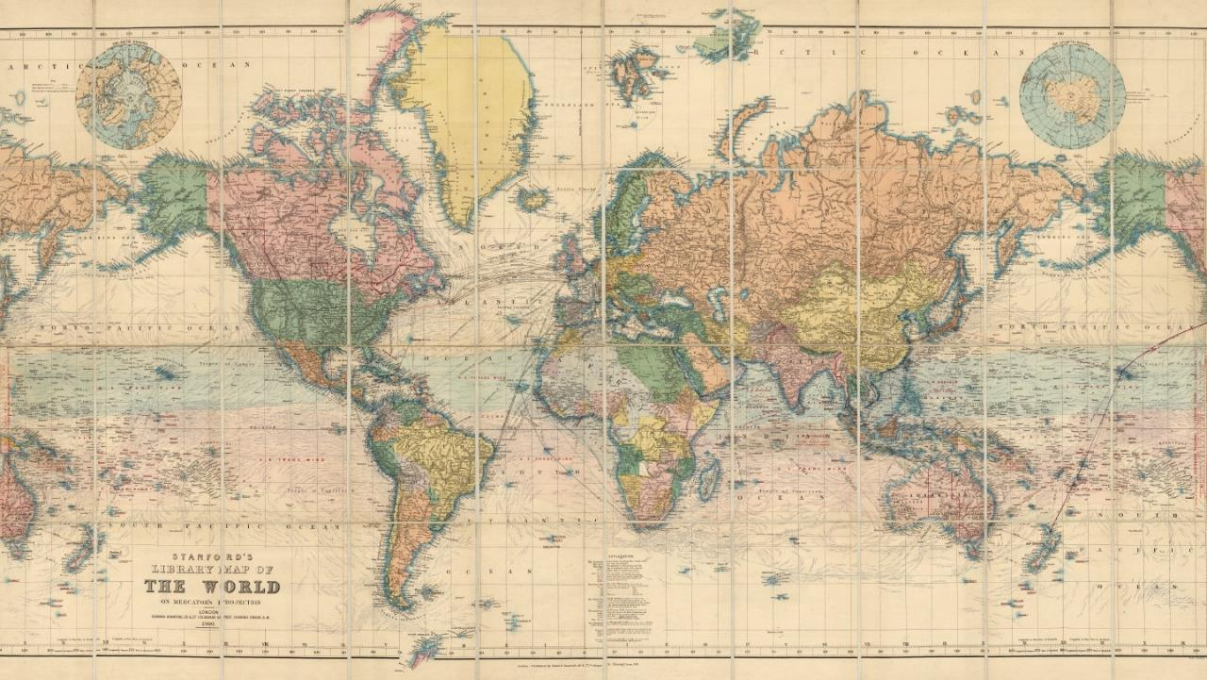
Notes:
Anywhere in the world. You are investing for your great, great grandchildren. Where do you invest it? Which country over the next 119 years will give you the highest stock market returns?

Slide 8
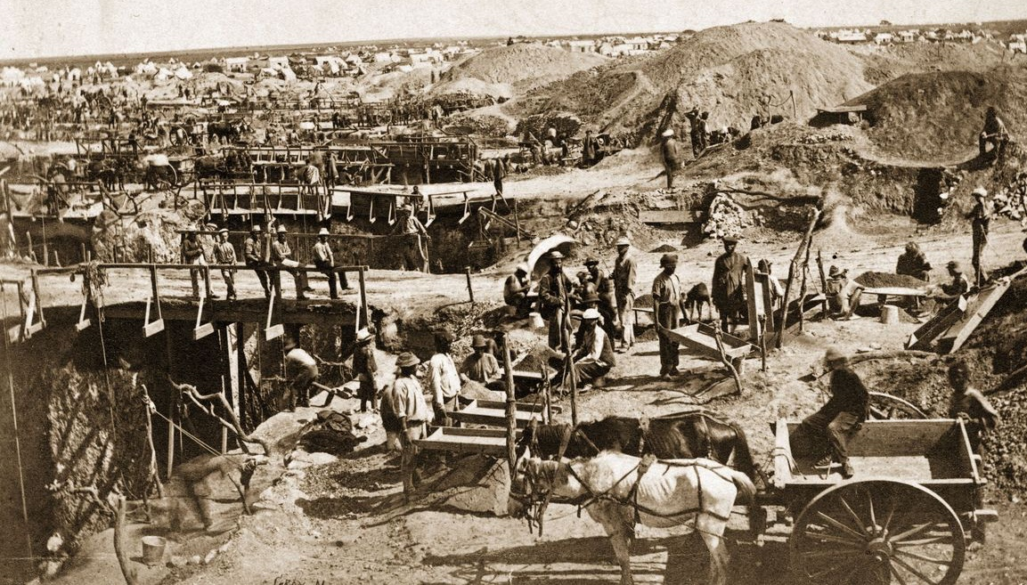
Notes:
A country best know for gold and diamonds

Slide 9
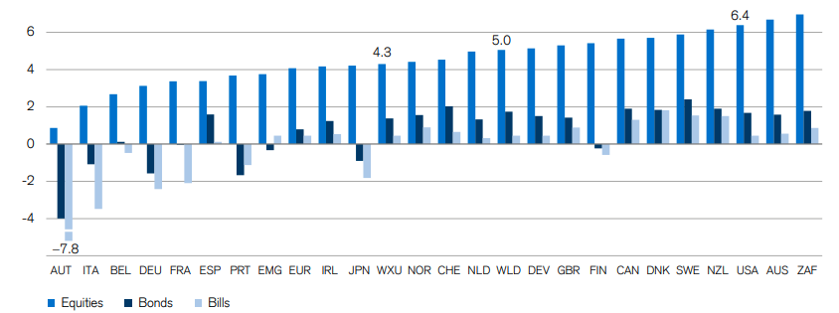
Growth of Wealth
Real annualized returns (%) on equities internationally, 1900 – 2022
South Africa
$5388
Sources: Elroy Dimson, Paul Marsh and Mike Staunton, DMS Database 2023, Morningstar. N Past performance does not guarantee future results. All data is from sources believed to be reliable but cannot be guaranteed or warranted. Real growth of wealth in local currency, after inflation. World portfolio is measured in USD.
Notes:
Here is what happened. Who would have thought South Africa would be #1 in local currency, growing at 7% per year on average. U.S. was #3 in Equities and #6 in Fixed Income

Slide 10
Money
Notes:
The fuel of capitalism, what makes it possible, is money.

Slide 11
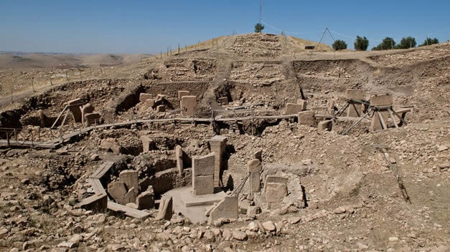

12000 BC
Notes:
The first money was Anatolian obsidian, a raw material for stone-age tools, distributed as early as 12,000 B.C., with organized trade occurring in the 9th millennium

Slide 12
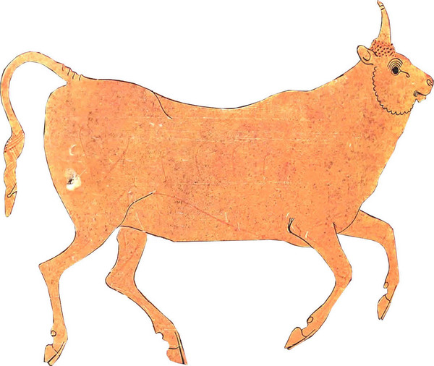
9000 BC
Notes:
Cattle were also used as currency. In ancient Greece, a trivet for cooking cost at least 12 cows;

Slide 13

8000 BC
Notes:
And then there was the cowrie, Cypraea moneta, the most important and widely used natural money of all times. Cowrie shells were used in China over many centuries, and from there spread to India into the pacific room to Arabia and Africa. In some African regions, cowries were used until the mid-20th century. The Classical Chinese character for "money/currency", 貝, originated as a pictograph of a cowrie shell.

Slide 14

1500 BC
Notes:
There's no gold or silver on Yap. But hundred of years ago, explorers from Yap found limestone deposits on an island hundreds of miles away. And they carved this limestone into huge stone discs, which they brought back across the sea on their small bamboo boats.
It's unclear if these stones started as money. But at some point the people on Yap realized what most societies realize. They needed something that everyone agrees you can use to pay for stuff. And like many societies, the people of Yap took the thing they had that was pretty — their version of gold — and decided that was money.
A piece of stone money was really valuable; you wouldn't use it for some everyday purchase. You'd use it for something big — a daughter's dowry, say.
One key thing about this money: It was really heavy. A big piece could weigh more than a car. As a result, this very concrete form of money quickly made the jump to being something very abstract. . They are mined on another island 250 miles away.
In fact, the stone doesn't even need to be on the island to count as money.
One time, according to the island's oral tradition, a work crew was bringing was bringing a giant stone coin back to yap on a boat. And just before they got back to the island, they hit a big storm. The stone wound up on the bottom of the ocean.
The crew made it back to the island and told everybody what happened. And everybody decided that the piece of stone money was still good — even though it was on the bottom of the ocean. Someone today owns this piece of stone money, even though nobody's seen it for over 100 years or more.
This system, in the end, feels really familiar. If you go online to pay your electric bill, what's really changing in the world?

Slide 15
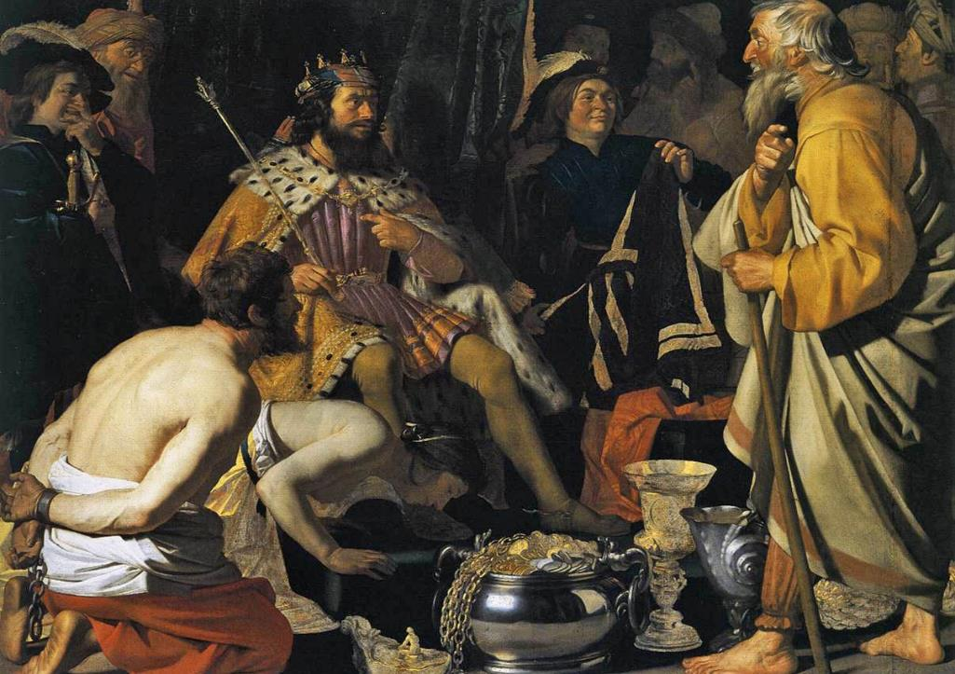
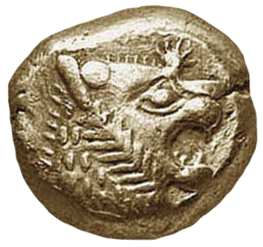
700 BC
Notes:
A big advance from barter was the development of the first coin, which occurred in Lydia in 700 BCE.

Slide 16
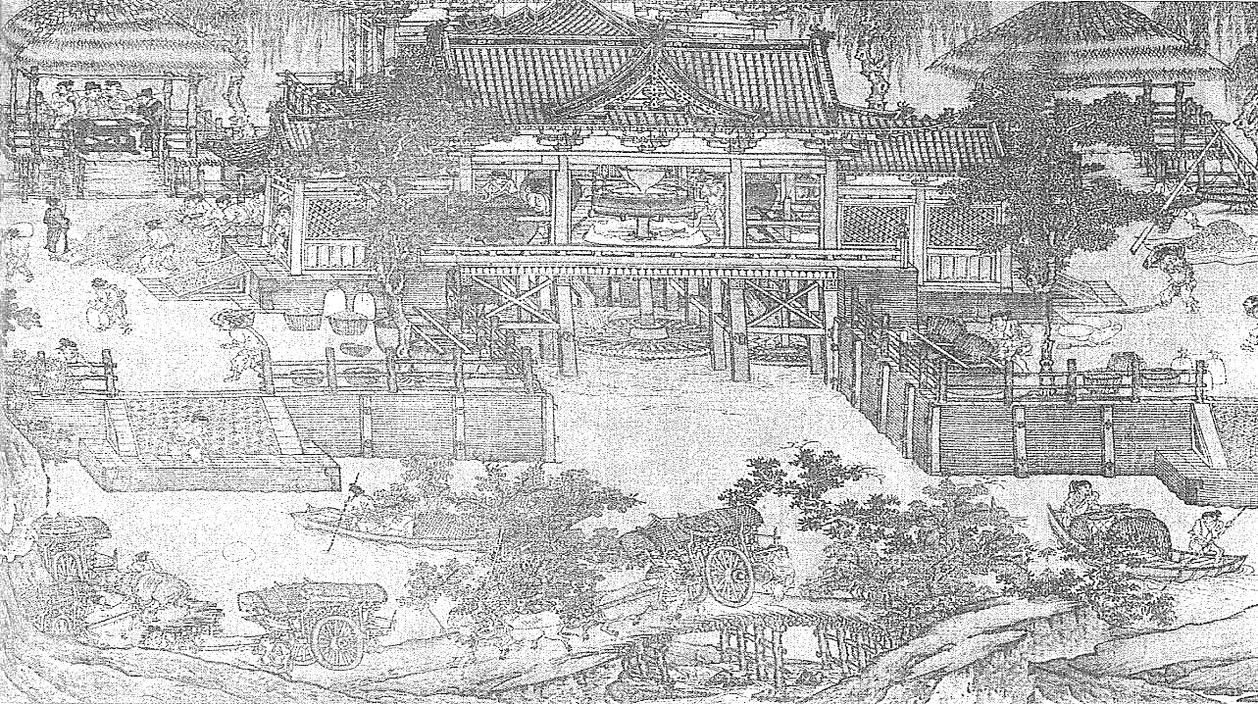
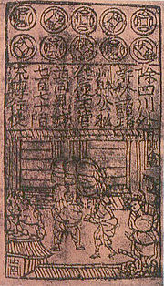
960
Notes:
Paper currency first developed in Tang Dynasty China during the 7th century, although true paper money did not appear until the 11th century, during the Song Dynasty. The usage of paper currency later spread throughout the Mongol Empire. Paper money originated in two forms: drafts, which are receipts for value held on account, and "bills", which were issued with a promise to convert at a later date.
Before the use of paper, the Chinese used coins that were circular, with a rectangular hole in the middle. Several coins could be strung together on a rope. Merchants in China, if they became rich enough, found that their strings of coins were too heavy to carry around easily. To solve this problem, coins were often left with a trustworthy person, and the merchant was given a slip of paper recording how much money he had with that person. If he showed the paper to that person he could regain his money. Eventually, the Song Dynasty paper money called "jiaozi" originated from these promissory notes. By 960 the Song Dynasty, short of copper for striking coins, issued the first generally circulating notes.

Slide 17
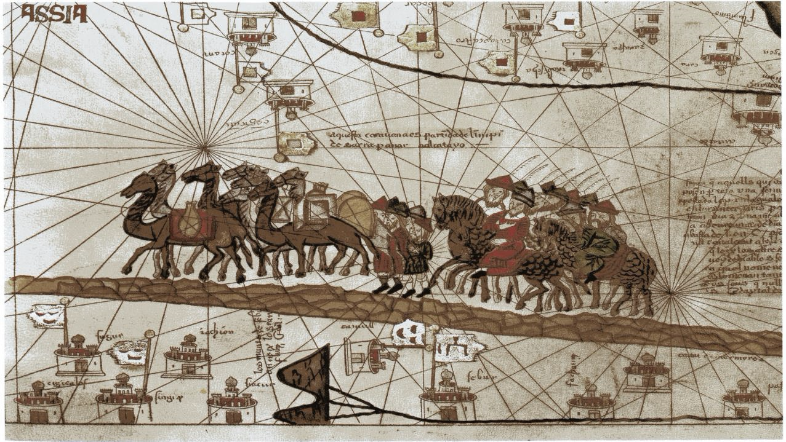
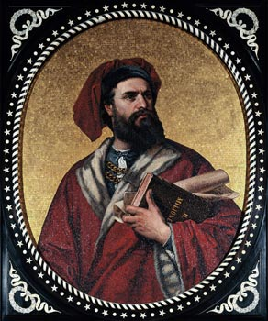
1300
Notes:
European explorers like Marco Polo introduced the concept of paper money in Europe during the 13th century.

Slide 18
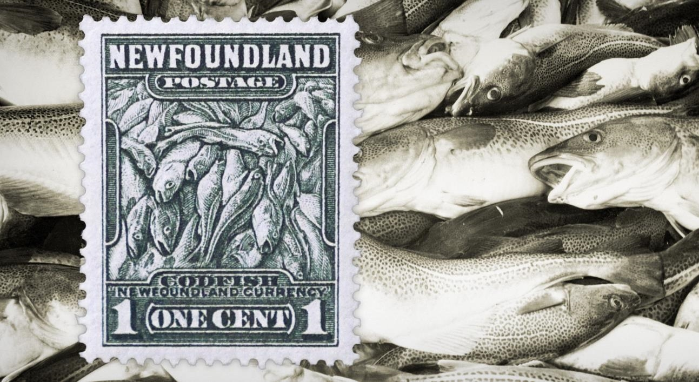
1600s
Notes:
Newfoundland used cod as a currency from the 1600s through to the 19th century .

Slide 19
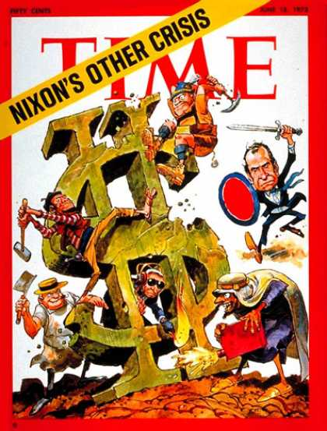
1971
Notes:
The fiscal strain of federal expenditures for the Vietnam War and persistent balance of payments deficits, led President Richard Nixon to end the direct international convertibility of the dollar to gold on August 15, 1971 (the "Nixon Shock").
This was meant to be a temporary measure with the gold price of the dollar and the official rate of exchanges remaining constant.
Within a year’s time, the new exchange rate became unrealistic because it would have required the United States to redeem more dollars than it had in gold and foreign currency reserves, or to contract the economy to increase the purchasing power of the dollar. In October 1973, the dollar was devalued . Once again, the devaluation was insufficient to hold the price of gold at that low a price; within two weeks of the second devaluation the dollar was left to float. In October 1976, the government officially changed the definition of the dollar; references to gold were removed from statute. From this point, the monetary system was made of pure fiat money

Slide 20

2008
Notes:
Bitcoin (BTC) is a digital currency first described in a 2008 paper by pseudonymous developer Satoshi Nakamoto, who called it a peer-to-peer, electronic cash system Bitcoin creation and transfer is based on an open source cryptographic protocol and is not managed by any central authority. Each bitcoin is subdivided into 100 million smaller units called satoshis, defined by eight decimal places. Bitcoins can be transferred through a computer or smartphone without an intermediate financial institution. Is this the future of money? Bitcoin mining uses as much energy each year as Argentinza Who knows?

Slide 21
Free Trade
Notes:
The next critical component of capitalism was free trade

Slide 22
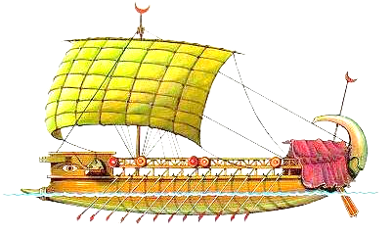
1200 BC
Notes:
Capitalism begins with trade. Phoenicia was an early example of a "world-economy" surrounded by empires. The high point of Phoenician culture and sea power is usually placed c. 1200–800 BC.
Towards the end of the Bronze Age (around 1200 BC) there was trade between the Canaanites (early Phoenicians), Egypt, Cyprus, and Greece.

Slide 23
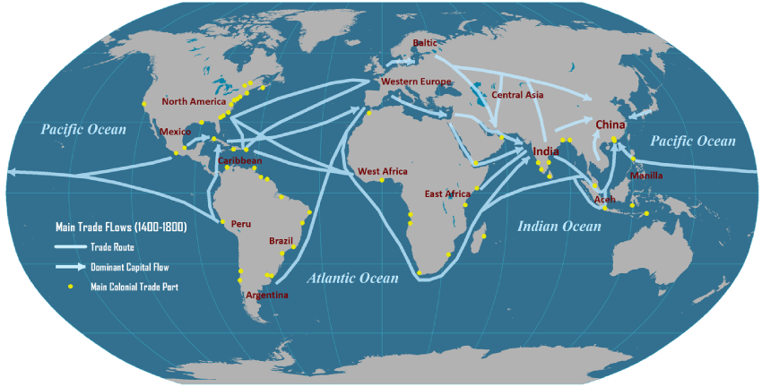
1400
Source: Transportgeography.org
Notes:
This shows the trade routes around the world from 1400 - 1800

Slide 24
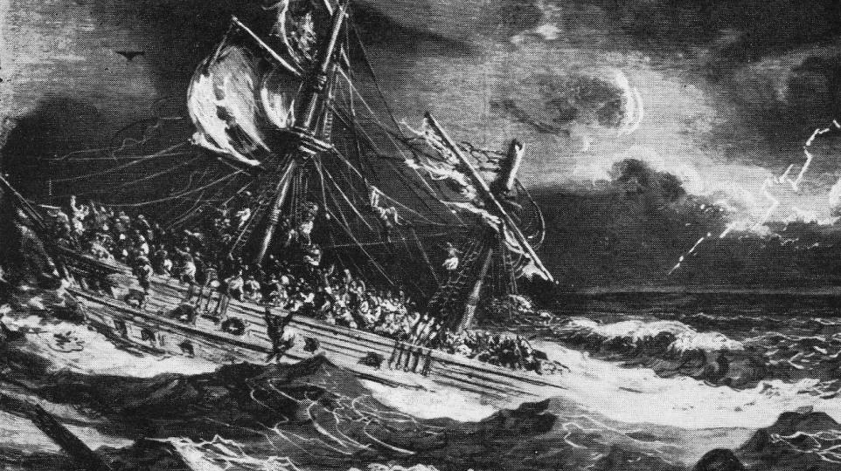
Notes:
But ships were risky and many were wrecked before they could return with their cargo. In the 16th century, with the expanding energies of the Atlantic kingdoms in a new era of ocean voyages, the situation changes. In long expeditions to distant and dangerous places, both the risk and the potential profit are greatly increased. A new system is called for.
Merchants risking their fortunes in these unpredictable adventures need a special level of support. Equally it suits governments to encourage their endeavors, for the sake of increasing trade but also to extend the nation's reach through settlements and colonies overseas..
Such undertakings tie up large sums for money for long periods before any profit can be realized, in the capital cost of ships and the expense of their crews on journeys lasting months and sometimes years. A large number of speculators need to be persuaded to share the risk.
The resulting organization is the joint-stock company, in which investors can contribute variable sums of money to fund the venture. In doing so they become joint holders of the trading stock of the company, with a right to share in any profits in proportion to the size of their holding.

Slide 25
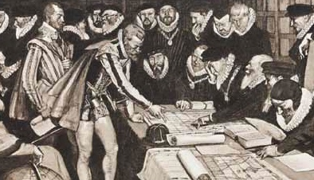

1600
Notes:
Labeled by both contemporaries and historians as "the grandest society of merchants in the universe", the British East India Company would come to symbolize the dazzlingly rich potential of the corporation, as well as new methods of business that could be both brutal and exploitative. On 31 December 1600, the English monarchy granted the company a 15-year monopoly on trade to and from the East Indies and Africa. By 1611, shareholders in the East India Company were earning an almost 150% return on their investment.
Largely through the efforts of the British East India Company and the Dutch East India Company, coffee became available in England
Dutch East India company paid 18% annual dividend for almost 200 years.

Slide 26
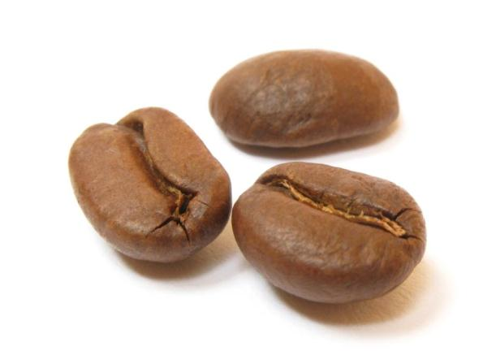
1616
Notes:
After petroleum, coffee is the second most heavily-traded commodity in the world,.
The earliest credible evidence of either coffee drinking or knowledge of the coffee tree appears in the middle of the fifteenth century, in the Sufi monasteries of the Yemen in southern Arabia. From Mocha, coffee spread to Egypt and North Africa, and by the 16th century, it had reached the rest of the Middle East, Persia and Turkey.
Coffee became more widely accepted after the controversy over whether it was acceptable for Catholics to consume it, was settled in its favor by Pope Clement VIII in 1600, despite appeals to ban the drink. The first European coffee house (apart from those in the Ottoman Empire, mentioned above) was opened in Venice in 1645.
Largely through the efforts of the British East India Company and the Dutch East India Company, coffee became available in England no later than the 16th century. By 1675, there were more than 3,000 coffeehouses throughout England, but there were many disruptions in the progressive movement of coffeehouses between the 1660s and 1670's. These coffee houses in England were places used for deep discussion of beliefs during the enlightenment, such as their thoughts on religious and political issues of their time. This practice of religious and political discussion became so common that Charles II made an attempt to crush coffee houses in 1675. By the way, there are only 500 Starbucks in England today.
The race among Europeans to make off with some live coffee trees or beans was eventually won by the Dutch in 1616. Pieter van der Broecke, a Dutch merchant, obtained some of the closely guarded coffee bushes from Mocha, Yemen in 1616. He took them back to Amsterdam and found a home for them in the Botanical gardens, where they began to thrive.
The beans that van der Broecke stole produced numerous healthy coffee bushes named Coffea Arabica. In 1658 the Dutch first used them to begin coffee cultivation in Ceylon (now Sri Lanka) and later in southern India. They abandoned the cultivation to focus on their Javanese plantations because they didn't want to oversupply the market and drop the price.
Within a few years the Dutch colonies (Java in Asia, Suriname in the Americas) had become the main suppliers of coffee to Europe.

Slide 27
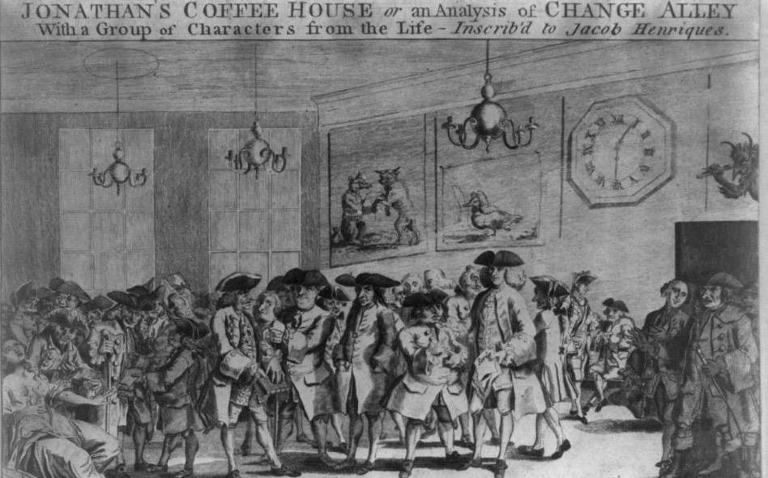
1698
Notes:
The joint-stock principle can equally well be applied to unincorporated companies (trading without a royal charter), many of which are set up in the 17th century. Investors can buy into a company even if they have no personal link with its trading activities. By the same token an investor's share in the company's stock can be sold at whatever price buyer and seller may agree upon. With this concept, one of the basic elements of capitalism evolves.
A natural next step is the emergence of specialist brokers, willing to arrange deals between buyers and sellers of shares in return for a cut on each transaction. In London the brokers gather at first in Jonathan's Coffee-House in Change Alley (Exchange Alley), famous as the original site of the London Stock Exchange. The Coffee-House was founded by Jonathan Miles, in Exchange Alley, around 1680.
.
In 1698, it was used by John Castaing to post the prices of stocks and commodities, the first evidence of systematic exchange of securities in London, England. That year, other dealers expelled from the Royal Exchange for rowdiness migrated to Jonathan's
The coffee houses were great social levellers, open to all men and indifferent to social status, and as a result associated with equality and republicanism. More generally, coffee houses became meeting places where business could be carried on, news exchanged and the London Gazette (government announcements) read. Lloyd's of London had its origins in a coffeehouse run by Edward Lloyd, where underwriters of ship insurance met to do business.

Slide 28
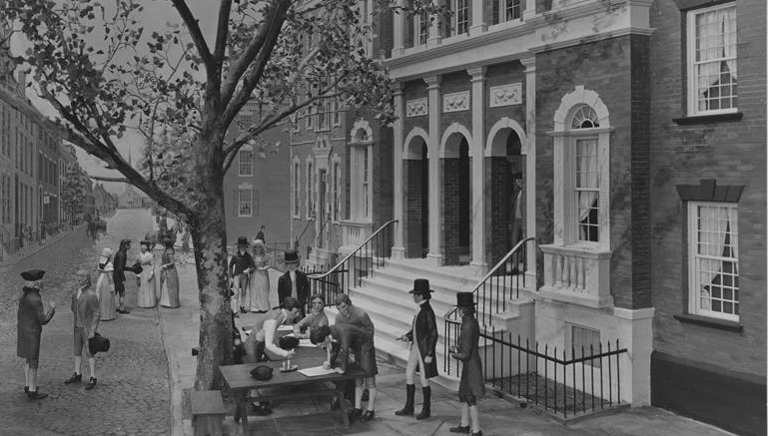
1792
Notes:
The Buttonwood Agreement, which took place on May 17, 1792, started the New York Stock & Exchange Board now called the New York Stock Exchange. This agreement was signed by twenty-four stock brokers outside of 68 Wall Street New York under a buttonwood tree.

Slide 29
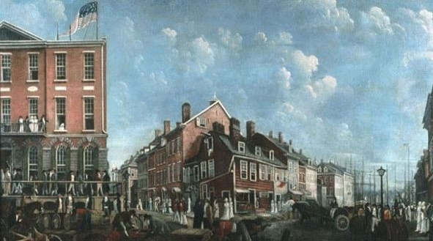
1793
Notes:
The next year, 1793, they moved into Tontine’s coffee house (the building with the flag) trading at the Tontine Coffee House continued until 1817.
The Bank of New York also started in a coffeehouse.

Slide 30
Innovation
Notes:
Another hallmark of Capitalism is innovation.

Slide 31
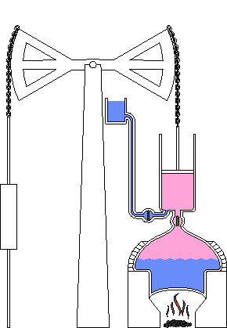
1712
Notes:
Thomas Newcomen with his "atmospheric-engine" of 1712 can be said to have brought together most of the essential elements in order to develop the first practical steam engine for which there could be a commercial demand.
Although inefficient and extremely heavy on coal (compared to later engines), these engines raised far greater volumes of water and from greater depths than had previously been possible

Slide 32
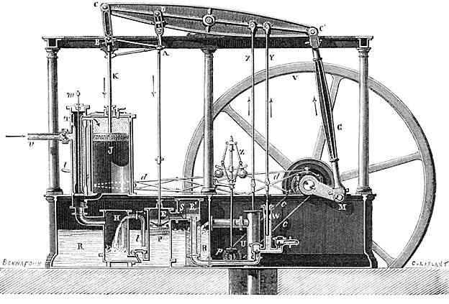
1775
Notes:
From here, James Watt creates his improved Steam engine in 1775.

Slide 33
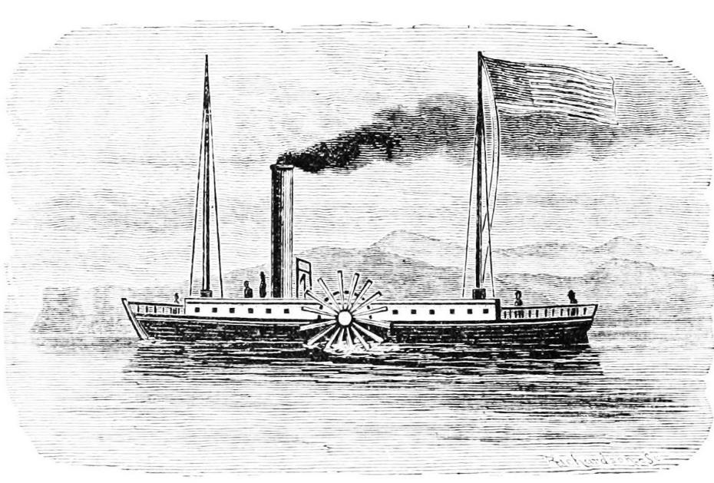
1807
Notes:
Other steam engine applications soon followed.
Robert Fulton and his steam engine arrived in New York in 1806, whereupon he engaged a shipbuilder on the East River to build a hull 150 feet long. Locally, this was referred to as "Fulton's folly", and some hostility arose among the local sailors - they would occasionally bump into the boat as they passed by, necessitating the hiring of guards.
The Clermont was completed in 1807, and despite an initial breakdown of its steam plant, steamed off towards Albany. On its initial voyage, the Clermont covered the 150 miles between New York and Albany in thirty two hours, and Fulton had the pleasure of passing many sailboats that were tacking back and forth against the prevailing headwind. The return voyage took thirty hours.

Slide 34
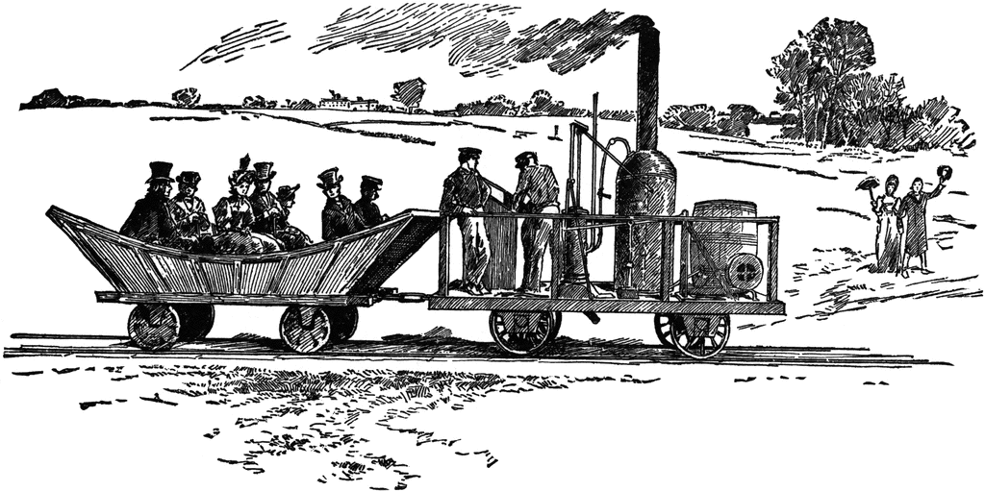
1830
Notes:
Peter Cooper manufactured the first steam powered railroad locomotive made in America, which was called Tom Thumb. 1830

Slide 35
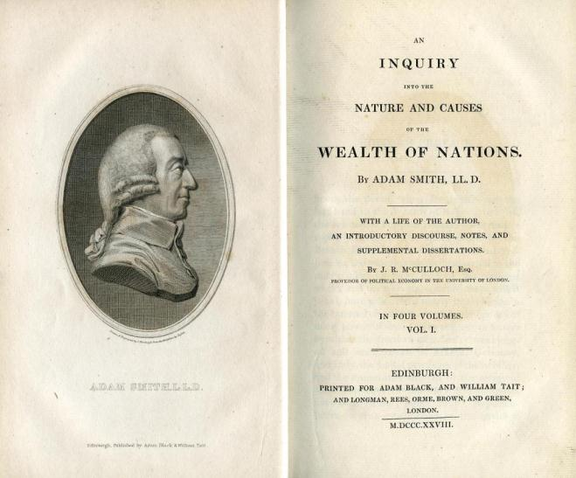
1776
Notes:
An Inquiry into the Nature and Causes of the Wealth of Nations, generally referred to by its shortened title The Wealth of Nations, is the magnum opus of the Scottish economist and moral philosopher Adam Smith. First published in 1776, the book offers one of the world's first collected descriptions of what builds nations' wealth and is today a fundamental work in classical economics. Through reflection over the economics at the beginning of the Industrial Revolution the book touches upon broad topics as the division of labor, productivity and free markets.
And the economist Adam Smith wrote much of his masterpiece “The Wealth of Nations” in the British Coffee House, a popular meeting place for Scottish intellectuals, among whom he circulated early drafts of his book for discussion.
Mercantalism held that wealth was finite – for Smith, it was infinite

Slide 36

Notes:
Smith observed that wealth used to be created by property

Slide 37
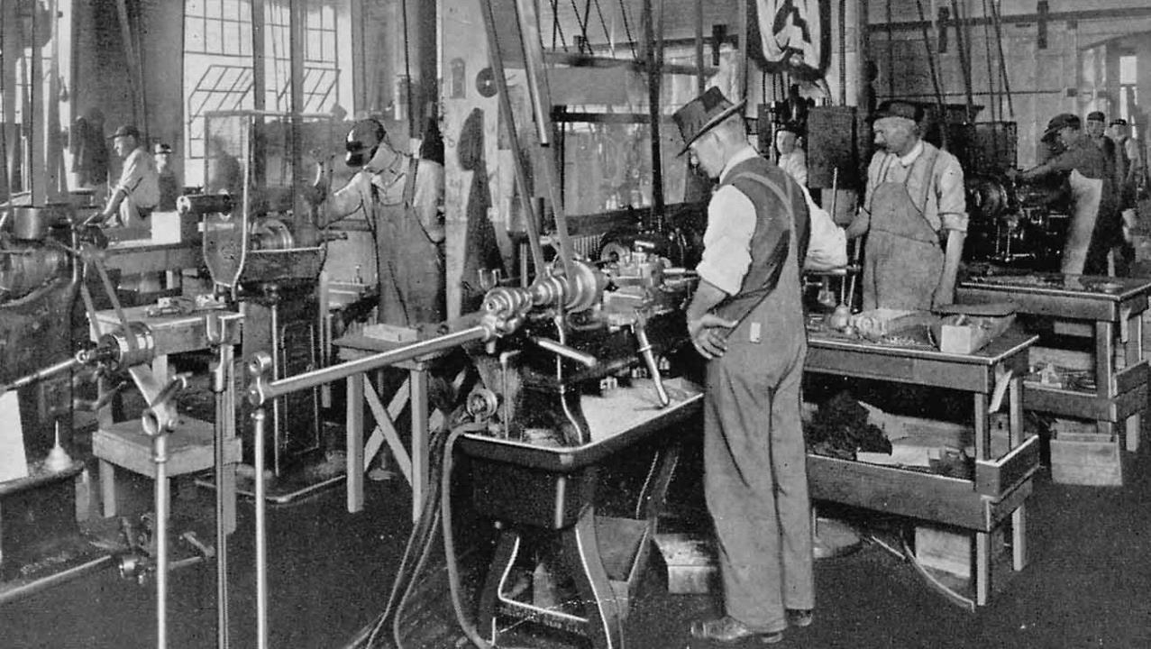
Notes:
Now it was created by labor

Slide 38

Notes:
Smith’s theory for the Invisible Hand states that if each consumer is allowed to choose freely what to buy and each producer is allowed to choose freely what to sell and how to produce it, the market will settle on a product distribution and prices that are beneficial to all the individual members of a community, and hence to the community as a whole. The reason for this is that self-interest drives actors to beneficial behavior in a case of serendipity. Efficient methods of production are adopted to maximize profits. Low prices are charged to maximize revenue through gain in market share by undercutting competitors. Investors invest in those industries most urgently needed to maximize returns, and withdraw capital from those less efficient in creating value. All these effects take place dynamically and automatically

Slide 39
“
It is not from the benevolence of the butcher, the brewer,
or the baker that we expect our dinner, but from their regard to their own interest.
- Adam Smith
“
Notes:
Read quote from Adam Smith

Slide 40
Challenges
Notes:
Of course capitalism is not perfect. It has faced a series of challenges over the centuries.

Slide 41
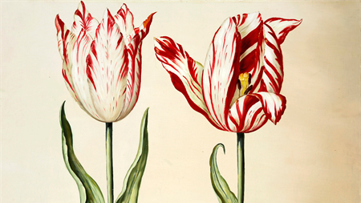
1637
Notes:
The tulip was introduced to the Netherlands in 1593 by the Flemish botanist Charles de l'Écluse, who received them from a Turkish ambassador. After the introduction its popularity started to grow. In 1623 the price of a popular variety tulip was already a thousand guilders. The average annual wage in that period was a hundred and fifty guilders. At its peak, prices of six thousand were recorded. The endpoint of the mania is very clear. In February 1637 the prices collapsed dramatically. Leaving many traders broke.
This image is of a Semper Augustus Tulip

Slide 42
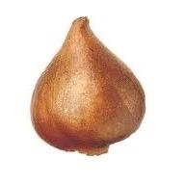
 | Guilders
Two lasts of wheat | 448
Four lasts of rye | 558
Four fat oxen | 480
Eight fat swine | 240
Twelve fat sheep | 120
Two hogsheads of wine | 70
Four tuns of beer | 32
Two tuns of butter | 192
One thousand lbs. of cheese | 120
A complete bed | 100
A suit of clothes | 80
A silver drinking-cup | 60
 | 2500
Source: “Memoirs of Extraordinary Popular Delusions and the Madness of Crowds,” by Charles Mackay, 1852
Notes:
According to the Historian, Charles Mackay: “In 1634, the rage among the Dutch to possess them was so great that the ordinary industry of the country was neglected, and the population, even to its lowest dregs, embarked in the tulip trade. As the mania increased, prices augmented, until, in the year 1635, many persons were known to invest a fortune of 100,000 guilders in the purchase of forty roots. It then became necessary to sell them by their weight in perits, a small weight less than a grain. A tulip of the species called Admiral Liefken, weighing 400 perits, was worth 4400 guilders ; an Admiral Van der Eyck, weighing 446 perits, was worth 1260 guilders ; a Childer of 106 peritswas worth 1615 guilders ; a Viceroy of 400 perits, 3000 guilders , and, most precious of all, a Semper Augustus, weighing 200 perits, was thought to be very cheap at 5500 guilders . The latter was much sought after, and even an inferior bulb might command a price of 2000 guilders . It is related that, at one time, early in 1636, there were only two roots of this description to be had in all Holland, and those not of the best. One was in the possession of a dealer in Amsterdam, and the other in Harlaem. So anxious were the speculators to obtain them, that one person offered the fee-simple of twelve acres of building-ground for the Harlaem tulip. That of Amsterdam was bought for 4600 guilders , a new carriage, two grey horses, and a complete suit of harness. Hunting, an industrious author of that day, who wrote a folio volume of one thousand pages upon the tulipomania, has preserved the folio wing list of the various articles, and their value, which were delivered for one single root of the rare species called the Viceroy:”

Slide 43
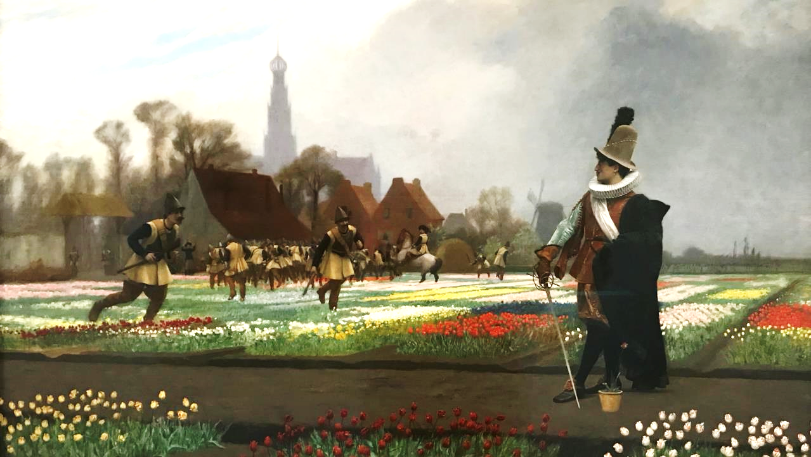
Notes:
Painting by Jean Leon Gerome of soldiers trampling tulip fields

Slide 44
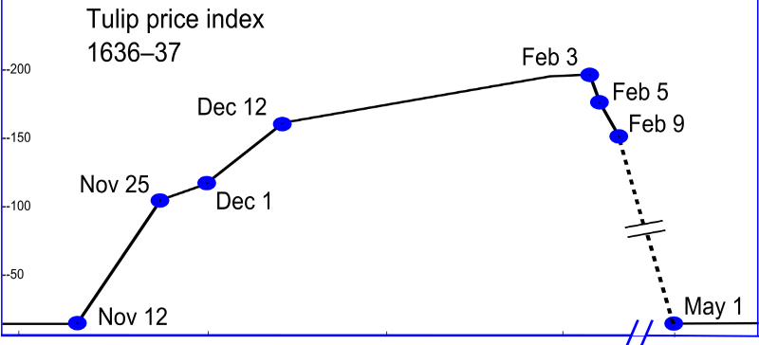
Source: “Memoirs of Extraordinary Popular Delusions and the Madness of Crowds,” by Charles Mackay, 1852. Past performance does not guarantee future results. All data is from sources believed to be reliable but cannot be guaranteed or warranted.
Notes:
The tulip mania in 1637, driving up the value of tulip bulbs by rampant speculation, made The Dutch East India Company the most valuable company in world history. With a value of 78 million Dutch Guilders, adjusted to 2013 dollars it was worth $7.4 trillion

Slide 45
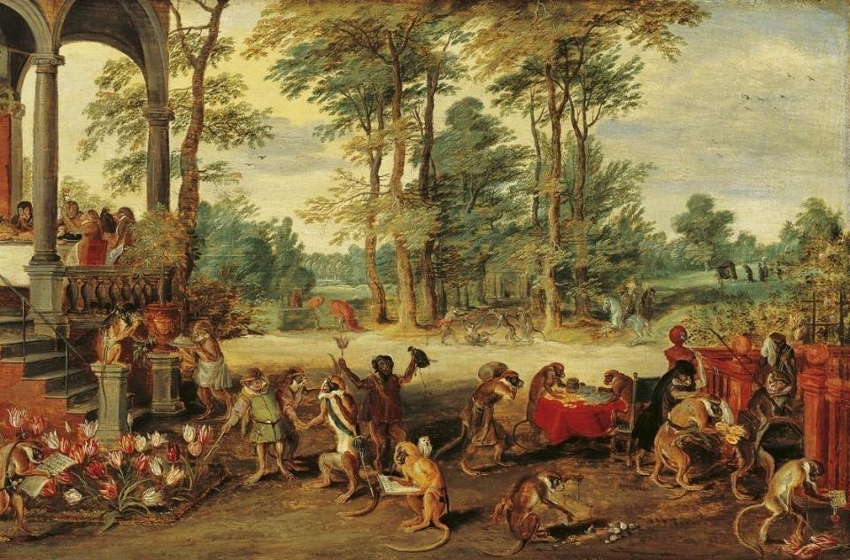
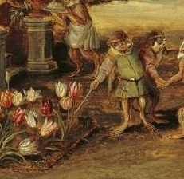
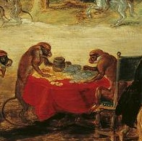
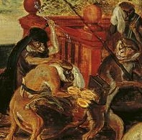
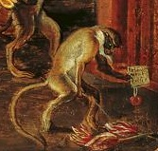
Notes:
A satire of the tulip mania, painted by Jan Brueghel the Younger. At left, one monkey points to flowering tulips while another holds up a tulip and a moneybag. Bulbs are weighed, money is counted, a lavish business dinner is enjoyed. The monkey at left has a list of rare tulips, his sword denotes upper class status. Farther back, a monkey sits like a nobleman astride a horse. One in mid-foreground draws up a bill of sale; the owl on his shoulder symbolizes foolishness and ignobility. Brueghel is not only ridiculing tulip speculators as brainless monkeys, the work is an object lesson for the folly of speculating to such an extent in such a transient thing as a mere bloom. In the denouement at right, a monkey urinates on the now worthless tulips; fellow speculators in debt are brought before the magistrate or weep in the dock. A frustrated buyer brandishes his fists, while at the back right a speculator is carried to his grave.

Slide 46
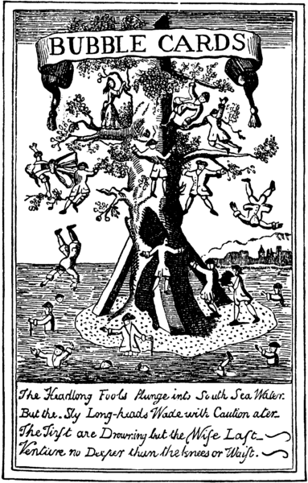
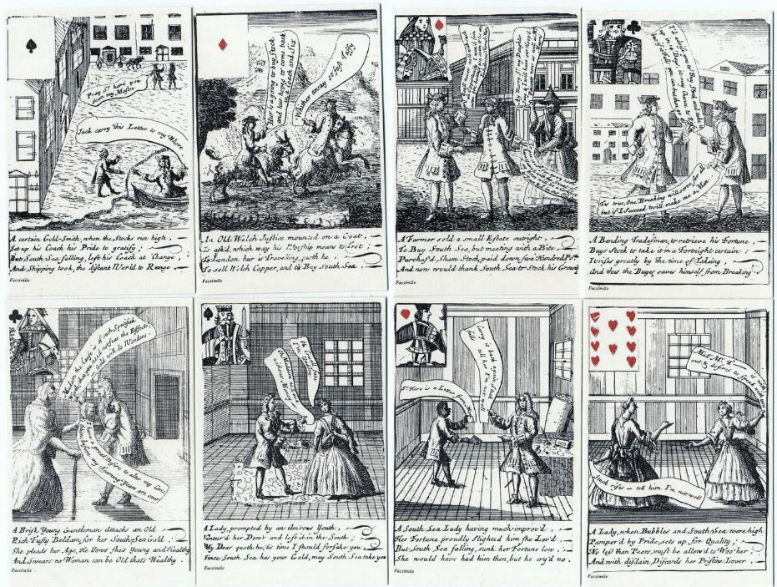
1711
Notes:
The South Sea Company (officially The Governor and Company of the merchants of Great Britain, trading to the South Seas and other parts of America, and for the encouragement of fishing) was a British joint-stock company founded in 1711, created as a public-private partnership to consolidate and reduce the cost of national debt. The company was also granted a monopoly to trade with South America, hence its name. At the time it was created, Britain was involved in the War of the Spanish Succession and Spain controlled South America. There was no realistic prospect that trade would take place and the company never realized any significant profit from its monopoly.
The South Sea company was by no means the only company seeking to raise money from investors in 1720. A large number of other joint-stock companies had been created making extravagant claims (sometimes fraudulent) about foreign or other ventures or bizarre schemes. Others represented potentially sound, although novel, schemes, such as for founding insurance companies. These were nicknamed "Bubbles".

Slide 47
Bubble Companies
For trading in hair
For buying and fitting out ships to suppress pirates
For improving of gardens
For insuring and increasing children’s fortunes
For a wheel for perpetual motion
For carrying on an undertaking of great advantage, but nobody
to know what it is
Notes:
Some of the bubble companies included schemes:
Read slide.
But the most absurd and preposterous of all, in the words of the historian Charles Mackay, “shewed, more completely than any other, the utter madness of the people, was one started by an unknown adventurer, entitled “A company for carrying on an undertaking of great advantage, but nobody to know what it is.” Were not the fact stated by scores of credible witnesses, it would be impossible to believe that any person could have been duped by such a project. The man of genius who essayed this bold and successful inroad upon public credulity, merely stated in his prospectus that the required capital was half a million, in five thousand shares of 100l. each, deposit 2l. per share. Each subscriber, paying his deposit, would be entitled to 100l. per annum per share. How this immense profit was to be obtained, he did not condescend to inform them at that time, but promised that in a month full particulars should be duly announced, and a call made for the remaining 98l. of the subscription. Next morning, at nine o’clock, this great man opened an office in Cornhill. Crowds of people beset his door, and when he shut up at three o’clock, he found that no less than one thousand shares had been subscribed for, and the deposits paid. He was thus, in five hours, the winner of 2000l. He was philosopher enough to be contented with his venture, and set off the same evening for the Continent. He was never heard of again.”

Slide 48
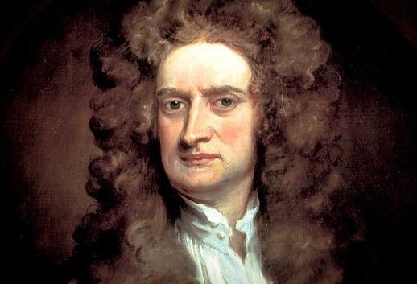
Notes:
Sir Isaac Newton, one of the smartest men of his day, was caught up in bubble fever.
By the way --it was a coffeehouse argument among several fellow scientists that spurred Isaac Newton to write his “Principia Mathematica,” one of the foundational works of modern science.

Slide 49
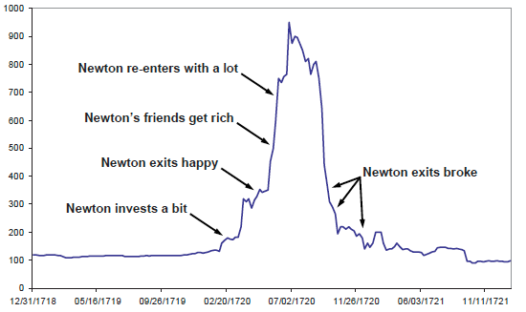
South Sea Stock (Dec. 1718 – Dec. 1721)
Source: www.marketoracle.co.uk. Past performance does not guarantee future results. All data is from sources believed to be reliable but cannot be guaranteed or warranted.
Notes:
Isaac Newton had the great good luck to get into the South Sea Bubble early. He made a really decent investment and a very quick killing, which mattered to him. It was enough to count. He then got out, and suffered the most painful experience that can happen in investing: he watched all of his friends getting disgustingly rich. He lost his cool and got back in, but to make up for lost time, he got back in with a whole lot more (some of it borrowed), nicely caught the decline, and was totally wiped out.
After that financial crash in 1720, called the South Sea Bubble, the British government was forced to undertake a bailout that eventually left several million pounds of debt on its books. Almost three centuries later, Britons are still paying interest on a small part of that obligation.

Slide 50
“
I can calculate the motion of heavenly bodies, but not the madness of people.
- Isaac Newton
“
Notes:
Newton's niece Catherine Conduitt reported that he "lost twenty thousand pounds. Of this, however, he never much liked to hear…"[ This was a fortune at the time (equivalent to about £2.4 million in present day terms or more than $3.1 million as of 12/2018

Slide 51
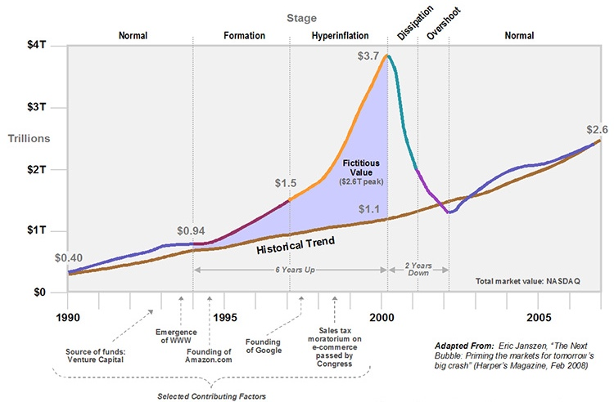
Dotcom Bubble
1994 – 2002
Adapted from Kampas Research: www.kampasresearch.com.
Past performance does not guarantee future results. All data is from sources believed to be reliable but cannot be guaranteed or warranted.
Notes:
But we still have bubble today, such as the techbubble

Slide 52











Notes:
According to a report on the "dot com bust" by Webmergers, Inc, 3,892 "dot com" companies were acquired by other companies, while 962 companies were shut down or went bankrupt.
11 months for pets.com from IPO to Bankruptcy

Slide 53
Notes:
But some companies survived the crash and thrived, and others like Facebook and YouTube were created post crash and created a new culture of innovation.

Slide 54
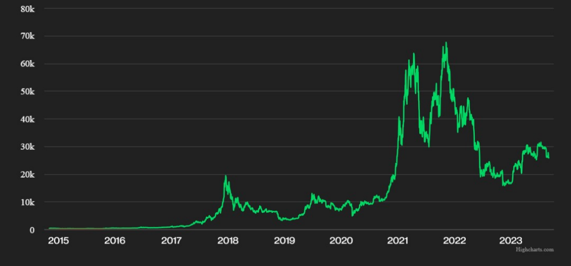
Daily $ Value of 1 Bitcoin
2015 – 9/1/2023
$68,991
$25,866
2015 2016 2017 2018 2019 2020 2021 2022
Past performance does not guarantee future results.
Source: www.coindesk.com
Notes:
But bubbles will always be with us. Perhaps this is a bubble for Bitcoin. Perhaps not. The future is unknowable. This chart shows the daily price of a single bitcoin in dollars. At it's high point in 2021, the collective value of the Bitcoin market would have been worth almost $1.5 trillion – worth more than the market cap of the 5 largest banks in the world,
Miners currently produce around 3,600 bitcoins per day, some portion of which they sell to cover electricity and other business expenses. The daily power cost of all mining is estimated around $500,000.

Slide 55

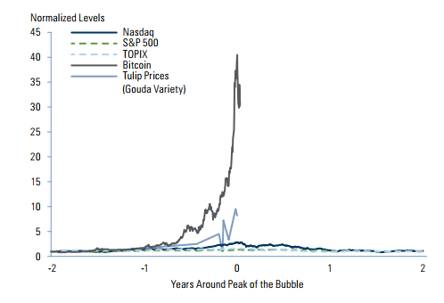
Bubbles Compared
+520%
Bitcoin Bubble
Tulip Bubble
Source: Goldman Sachs 2018 Outlook: (Un)Steady as She Goes. Past performance does not guarantee future results. All data is from sources believed to be reliable but cannot be guaranteed
or warranted.
Notes:
This shows how various bubbles from the Tech bubble in 2000 to the Japanese market bubble to Bitcoin (through 2022) to tulips stacked up against each other

Slide 56
“I got out of tulips after the market collapsed, but I’m slowly getting back in. Especially pink ones.”
Notes:
Read slide

Slide 57
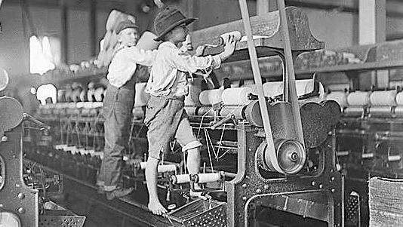
Notes:
The industrial revolution had a huge social cost -- from child labor…

Slide 58
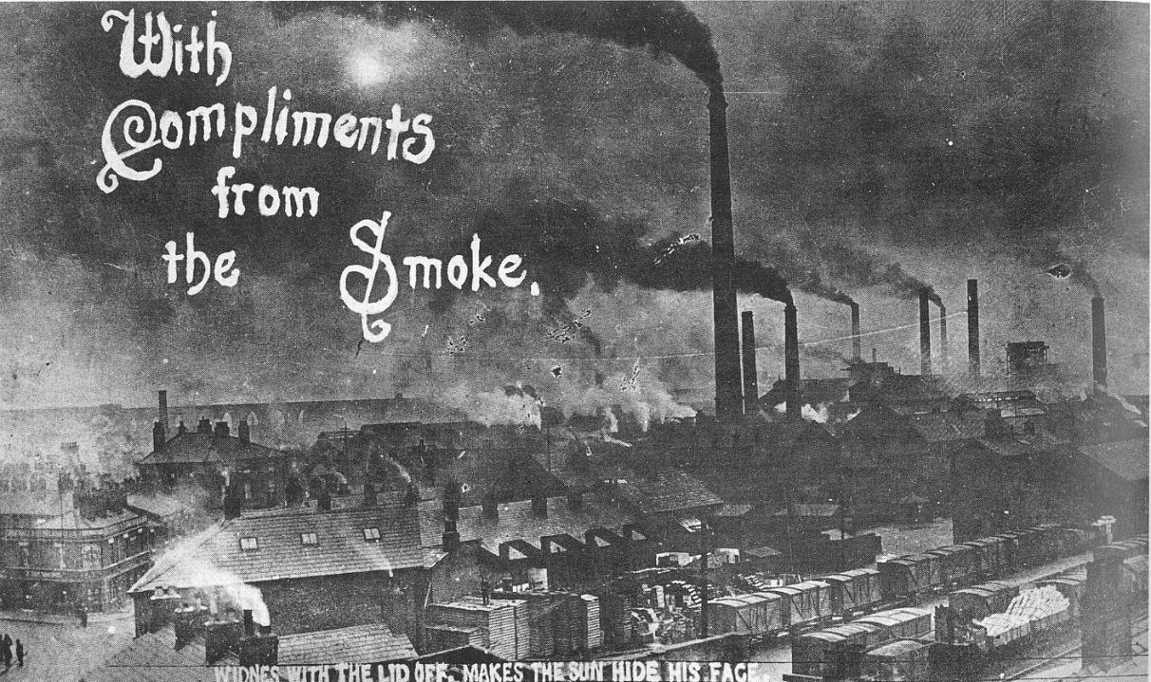
Notes:
To pollution…

Slide 59
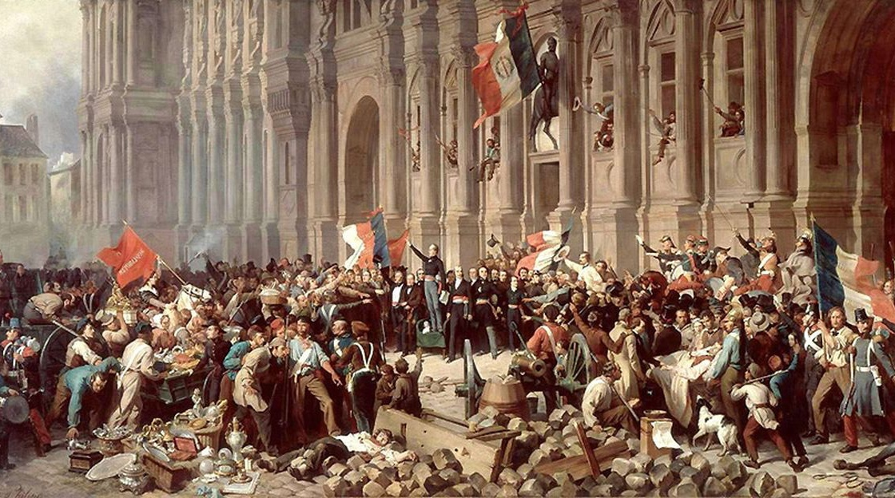
Notes:
To the European Revolutions of 1848, known in some countries as the Spring of Nations, a series of political upheavals throughout Europe in 1848.
It remains the most widespread revolutionary wave in European history, but within a year, reactionary forces had won out, and the revolutions collapsed.
Over 50 countries were affected, but with no coordination or cooperation among the revolutionaries in different countries. Five factors were involved: widespread dissatisfaction with political leadership; demands for more participation in government and democracy; the demands of the working classes; the upsurge of nationalism; and finally, the regrouping of the reactionary forces based on the royalty, the aristocracy, the army.

Slide 60
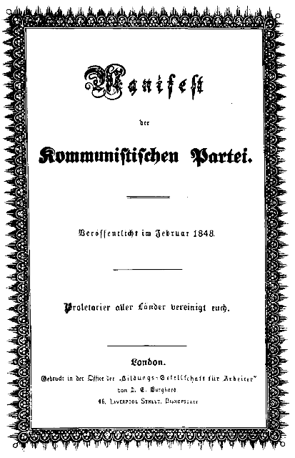
1848
Notes:
The first chapter of Marx’s Communist Manifesto, "Bourgeois and Proletarians", examines the Marxist conception of history, with the initial idea asserting that "The history of all hitherto existing society is the history of class struggles". It goes on to say that in capitalism, the working class, proletariat, are fighting in the class struggle against the owners of the means of production, the bourgeois, and that past class struggle ended either with revolution that restructured society, or "common ruin of the contending classes".
The Manifesto explains that the reason the bourgeois exist and exploit the proletariat with low wages is private property, "the accumulation of wealth in private hands, the formation and increase of capital", and that competition amongst the proletariat creates wage-labour, which rests entirely on the competition among the workers.
The proletariat rise to power through revolution against the bourgeoisie such as riots or creation of unions. The Communist Manifesto states that while there is still class struggle amongst society, capitalism will be overthrown by the proletariat; ultimately communism is the key to class equality amongst the citizens of Europe.

Slide 61
“
Capital is dead labor, which, vampire-like, lives only by sucking living labor, and lives the more, the more labor it sucks.
- Karl Marx
“
Notes:
Read slide

Slide 62

currently led by communist/socialist governments
2020
previously led by communist/socialist governments
Notes:
Communism was a powerful force for a time. Here are countries of the world now (red) or previously (orange) which were led by nominally communist (Marxist-Leninist) governments as of 2019. At its height, 1/3 of world’s pop lived under communism. 94 million killed by Communist regimes

Slide 63
Freedom
Notes:
Finally, I believe freedom and capitalism go hand in hand.

Slide 64

1989
Notes:
The Berlin Wall (German: Berliner Mauer) was a barrier constructed by the German Democratic Republic (GDR, East Germany) starting on 13 August 1961, that completely cut off (by land) West Berlin from surrounding East Germany and from East Berlin. The Berlin Wall was officially referred to as the "Anti-Fascist Protection Rampart" (German: Antifaschistischer Schutzwall) by GDR authorities. Between 1961 and 1989, the wall prevented almost 5,000 people who attempted to escape over the wall, with an estimated death toll of over 600.
In 1989, a series of radical political changes occurred in the Eastern Bloc, associated with the liberalization of the Eastern Bloc's authoritarian systems and the erosion of political power in the pro-Soviet governments in nearby Poland and Hungary.
The physical Wall itself was primarily destroyed in 1990. The fall of the Berlin Wall paved the way for German reunification, which was formally concluded on 3 October 1990.

Slide 65

The Path to Democratization
Source: Freedom House 2023
Notes:
Though the number of free countries has generally been decreasing slightly in recent years, I believe there is a high correlation between free political systems and free markets. IT is difficult for a market to perform well over time if it is hampered by an autocratic political system. But like everything else, there are exceptions. Almost half the world’s population now lives in a democracy. From 11 democracies in 1941 to 31 democracies before Berlin Wall fell to more than 72 now.

Slide 66


The Incredible Decline in Global Poverty
1990 – 2022
From
35%
living on $1.90 a day to
8.4%
Source: The World Bank “Poverty & Shared Prosperity 2018 and 2023 Note: Poverty is measured using the US$1.90-a-day 2011 purchasing power parity (PPP) poverty line. Past performance does not guarantee future results. All data is from sources believed to be reliable but cannot be guaranteed or warranted.
Notes:
Despite the many valid criticisms of global capitalisms, one important and often overlooked change it has wrought is helping cut the percentage (and number) of people living in absolute poverty, defied as less than $1.90 per day from 35% to 8.4% from 1990 – 2022 (though COVID was definitely a setback). There are broader reasons for hope, including astonishing progress against global poverty — more than 100 million children’s lives saved since 1990. Every day, another 300,000 people worldwide get their first access to electricity, and 285,000 to clean water. Global poverty is a huge opportunity, for we now have a much better understanding of how to defeat it: resolve conflicts, invest in girls’ education, empower women, fight malnutrition, support family planning, and so on.
For the first time in human history, less than 10 percent of the world’s population is living in extreme poverty, and we probably could virtually eliminate it over the next 15 years if it were a top global priority.

Slide 67
Notes:
This is the Korean Peninsula at night. Guess which part is North Korea?
Let’s look at the two Koreas as a case study of capitalism vs. communism

Slide 68

Korean Per Capita GDP
1950 - 202
$34,997 (2021)
South Korea GDP
North Korea GDP
$1,300 (2016 est.)
2018
Sources: Agnus Madison through 2014; 2016/2019 data are CIA World Factbook Estimate. Past performance does not guarantee future results. All data is from sources believed to be reliable but cannot be guaranteed or warranted.
Notes:
Here is how South and North Korea GDP per capita has varied through 2020 ( the numbers for North Korea are a very rough estimate for 2016 from the CIA, since it is very hard to get accurate info out of the “hermit kingdom”)

Slide 69
South Korea vs. North Korea
83
Years Old
73
Years Old
15
North Korea
1.8
South Korea
North Korea
South Korea
Infant Mortality (per 1,000 births)
Life Expectancy at Birth
Source: World Health Organization, CIA World Factbook. For 2020. Past performance does not guarantee future results. All data is from sources believed to be reliable but cannot be guaranteed or warranted.
Notes:
In 2020 the key statistic is life expectancy at birth (total population) -- 70in N. Korea vs. 82 in S. Korea
Read slide.

Slide 70

International Market Returns (2003 – 2022)
Budweiser
Bang & Olufsen
Michelin
Adidas
Hoover
Prada
7-11
Shell
Frigidaire
Source: In US dollars. MSCI country indices (net dividends) for each country listed. Does not include Israel, which MSCI classified as an emerging market prior to May 2010. MSCI data © MSCI 2023, all rights reserved. Past performance is not indicative of future results. Performance in U.S. Dollars Annualized Returns Companies listed are for illustrative purposes only and are not to be viewed as investment recommendations. Past performance does not guarantee future results. All data is from sources believed to be reliable but cannot be guaranteed or warranted.
Notes:
While the US outperformed the majority of countries comprising developed and emerging markets, the long-term picture still points to a need for international diversification,
Nobody knows what the future will bring. But if you own a lot of companies around the world you can worry less if any one company or even one country experiences losses. Nor do you need to be as concerned about picking countries that might outperform.

Slide 71

Emerging Market Returns (2003 – 2022)
Pilgrim’s
Lenovo
Jaguar Land Rover
Samsung
Giant Bicycles
Source: In US dollars. MSCI country indices (net dividends) for each country listed. Does not include Greece, which MSCI classified as a developed market prior to November 2013, or Russia, which MSCI classifies as a standalone market as of March 2022.. Additional countries excluded due to data availability or due to downgrades by MSCI from emerging to frontier market. MSCI data © MSCI 2023, all rights reserved. Past performance is not indicative of future results. Performance in U.S. Dollars Annualized Returns Companies listed are for illustrative purposes only and are not to be viewed as investment recommendations. Past performance does not guarantee future results. All data is from sources believed to be reliable but cannot be guaranteed or warranted.
Notes:
While the US outperformed the majority of countries comprising developed and emerging markets during 2019, the long-term picture still points to a need for international diversification, with the U.S. coming in 2ndout of 46 countries in terms of 10-year stock market returns.
Nobody knows what the future will bring. But if you own a lot of companies around the world you can worry less if any one company or even one country experiences losses. Nor do you need to be as concerned about picking countries that might outperform.

Slide 72
Entrepreneurship & Disruption

Slide 73

1942
Notes:
When Joseph Schumpeter made his famous prediction in Capitalism, Socialism and Democracy that capitalism was doomed to fail and socialism was destined to rise, it was a time (1942) in which a plurality, if not a majority, of the world's people were living under totalitarian or communist governments. Schumpeter asked, "Can capitalism survive?" and answered, simply, "No."
Schumpeter claimed that he had set himself three goals in life: to be the greatest economist in the world, to be the best horseman in all of Austria and the greatest lover in all of Vienna. He said he had reached two of his goals, but he never said which two.
Schumpeter's theory is that the success of capitalism will lead to a form of corporatism and a fostering of values hostile to capitalism, especially among intellectuals. The intellectual and social climate needed to allow entrepreneurship to thrive will not exist in advanced capitalism; it will be replaced by socialism in some form. There will not be a revolution, but merely a trend in parliaments to elect social democratic parties of one stripe or another. He argued that capitalism's collapse from within will come about as democratic majorities vote for restrictions upon entrepreneurship that will burden and destroy the capitalist structure, but also emphasizes non-political, evolutionary processes in society where "liberal capitalism" was evolving into democratic socialism.
The research of entrepreneurship owes much to his contributions. Schumpeter argued that the innovation and technological change of a nation come from the entrepreneurs, or wild spirits. He coined the word Unternehmergeist,
Schumpeter identified innovation as the critical dimension of economic change. He argued that economic change revolves around innovation, entrepreneurial activities, and market power.

Slide 74

“
Economic progress,
in capitalist society, means turmoil.
- Joseph Schumpeter
“
Notes:
Read slide

Slide 75

1886
Notes:
Let’s look at turmoil and creative destruction via cars.
The Benz Motorwagen was the first automobile entirely designed as such to generate its own power, not simply a motorized-stage coach or horse carriage, which is why Karl Benz was granted his patent and is regarded as its inventor.
The first Motorwagen was built in 1886
Benz's Model 3 made its wide-scale debut to the world in the 1889 World's Fair in Paris; about twenty-five Motorwagens were built between 1886 and 1893.

Slide 76

1903
Notes:
The Ford Motor Company was started in 1903. The Model T production system, the epitome of Fordism, is famous for representing the rigidity of early mass production systems that were wildly successful at achieving efficiency but that could accommodate changes in product design only with great difficulty and resistance.
The standard 4-seat open tourer of 1909 cost $850 ($21,080 today) ; in 1913, the price dropped to $550 and $440 in 1915. In 1914, an assembly line worker could buy a Model T with four months' pay.
By the 1920s, the price had fallen to $260 because of increasing efficiencies of assembly line technique and volume (about $7000 today) .

Slide 77

1914
Notes:
Ford's cars came off the line in three minute intervals.
Ford astonished the world in 1914 by offering a $5 per day wage ($110 today), which more than doubled the rate of most of his workers. The move proved extremely profitable; instead of constant turnover of employees, the best mechanics in Detroit flocked to Ford, bringing their human capital and expertise, raising productivity, and lowering training costs. He wanted the best person for the job. Wall Street didn’t approve of these “liberal” policies.

Slide 78

1915
Notes:
But soon Detroit was booing. The number of U.S. carmakers peaked at 272 in 1909, including major manufacturers in New England and Ohio. During the 1910s, however, the Detroit brands pulled away. In 1915, 13 out of the country’s 15 most popular car brands were in Detroit. Motor City executives, particularly Ford, invested heavily in research and development, distancing their products from the out-of-towners. Then things started to change…
http://www.slate.com/articles/news_and_politics/explainer/2012/02/why_are_all_the_big_american_car_companies_based_in_michigan_.html

Slide 79

Notes:
Packard Avenue -- part of the Packard Auto Plant, built in 1903

Slide 80

Notes:
Plant closed in 1958, but was occupied by other firms until the late 1990s.

Slide 81

Notes:
Detroit in 1949

Slide 82

Notes:
Detroit in 2003

Slide 83

1947
Notes:
Just up the road in 1947 in Menlo Park, Hewlett Packard (HP) was founded in a garage. HP is a computer firm which would transform technology and computing and become one of the 20 largest companies in America as well as the grandfather of Silicon Valley.

Slide 84

1965
Notes:
1966/1965 were an epochal era in American computing. A groundbreaking and prescient Time Magazine article was published in April of 1965 on “The Computer in Society,” which detailed all the ways computers were changing the world.
According to the article, “As the most sophisticated and powerful of the tools devised by man, the computer has already affected whole areas of society, opening up vast new possibilities by its extraordinary feats of memory and calculation….It has given new horizons to the fields of science and medicine, changed the techniques of education and improved the efficiency of government. It has affected military strategy, increased human productivity, made many products less expensive and greatly lowered the barriers to knowledge.”
Time noted that IBM was then the leading global computer company, with 74% of the U.S. computer market, “a dominance that leads some to refer to the industry as ‘IBM and the Seven Dwarfs.’ The dwarfs, small only by comparison with giant IBM: Sperry Rand, RCA, Control Data, General Electric, NCR, Burroughs, Honeywell.
But Time’s reporting was already behind the times, neglecting to mention Hewlett Packard (HP), which would enter the computer market in 1966 with the HP 2116A minicomputer — one of the first portable and “plug and play” computers.

Slide 85





IBM and the Seven Dwarfs
Logos for IBM: Sperry Rand, RCA, Control Data, General Electric, NCR, Burroughs, Honeywell
Notes:
What if you – or your parents or grandparents were convinced by the Time article that computers would change the world and called your stockbroker and invested $100 in IBM as well as in each of the Seven Dwarfs at the beginning of 1966. After all, you wouldn’t want to put all your money in just one stock. You’ve also heard something about HP, so you invest $100 in their stock, as well as $100 in an index fund that tried to replicate the S&P 500 for a little more diversification. If you’d stayed invested for the next 50+ years through 2016, what would have happened.
First of all, a couple of firms changes names. RCA became Voxx, Sperry Rand became Unisys, Burroughs was purchased by Unisys and Control Data went out of business

Slide 86

Growth of $100 Dollars With Dividends
(1966 - 2017)
Source: S&P 500, DFA Returns 2.0, Morningstar 2017., Yahoo Finance, Hypothetical value of $100 invested at beginning of 1966 and kept invested through December 31, 2016 Assumes reinvestment of income and no transaction costs or taxes. This is for illustrative purposes only and not indicative of any investment. Stock investing involves risks, including increased volatility (up and down movement in the value of your assets) and loss of principal. Indexes are unmanaged baskets of securities in which investors cannot directly invest. Past performance does not guarantee future results. All data is from sources believed to be reliable but cannot be guaranteed or warranted
¹ Inception Date: 06/1987; ²Inception Date: 06/1972; ³Inception Date: 01/1970
Notes:
So how did it do. First, here is the S&P 500 Index over this time. And IBM and the remaining seven dwarves, as well as HP…

Slide 87

Notes:
Let’s look at another company, what became Altria…

Slide 88
Notes:
According to the Motley Fool.com, the top performing stock of the last 50 years was Altria/Phillip Morris.
Other string performers over this time include Coca-Cola and PepsiCo

Slide 89
Notes:
So let’s compare the Marlboro man to high tech. The past to the future…

Slide 90
Growth of $100 Dollars With Dividends
(1966 - 2017)
C
Source: S&P 500, DFA Returns 2.0, Morningstar 2017., Yahoo Finance, Hypothetical value of $100 invested at beginning of 1966 and kept invested through December 31, 2016 Assumes reinvestment of income and no transaction costs or taxes. This is for illustrative purposes only and not indicative of any investment. Stock investing involves risks, including increased volatility (up and down movement in the value of your assets) and loss of principal. Indexes are unmanaged baskets of securities in which investors cannot directly invest. Past performance does not guarantee future results. All data is from sources believed to be reliable but cannot be guaranteed or warranted
¹ Inception Date: 06/1987; ²Inception Date: 06/1972; ³Inception Date: 01/1970
Notes:
So how did it do. First, here is the S&P 500 Index over this time. And IBM and the remaining seven dwarves, as well as HP…

Slide 91

$24,331
$100 invested in 1966 - 2017 (with dividends reinvested)
Source: Yahoo Finance. Past performance does not guarantee future results. All data is from sources believed to be reliable but cannot be guaranteed or warranted
Notes:
Some other companies that were top performers over this period include Pepsi, which returned $21,084 for $100 invested in 1966.

Slide 92

$38,071
$100 invested in 1966 - 2017 (with dividends reinvested)
Source: Yahoo Finance. Past performance does not guarantee future results. All data is from sources believed to be reliable but cannot be guaranteed or warranted
Notes:
And Coke which returned $34,403 for $100 invested in 1966

Slide 93

U.S. Transportation
Cumulative value of $1 invested 1900 - 2015
Rail
$62,716
Market
$39,134
Road Transport (since 1926)
$10,570
Air
(since 1934)
$7,090
Credit Suisse Global Investment Returns Yearbook – 2015 Elroy Dimson, Paul Marsh and Mike Staunton; DMS USA index; other indices compiled from CRSP. Elroy Dimson, Paul Marsh and Mike Staunton, Triumph of the Optimists: 101 Years of Global Investment Returns, Princeton University Press, 2002. Past performance does not guarantee future results. All data is from sources believed to be reliable but cannot be guaranteed or warranted
Notes:
In addition, old industries often continue to be surprisingly profitable. Consider the U.S. Dow Jones transportation index. From 1900 – 2015, railroads were the top performers, beating airlines, road transport (which joined the index in 1926) and the U.S. market, while airlines (which joined the index in 1934) trailed the market substantially. The Dow Jones U.S. Transportation Average (DJTA), also called the "Dow Jones Transports," is a U.S. stock market index from S&P Dow Jones Indices of the transportation sector, and is the most widely recognized gauge of the American transportation sector. It is the oldest stock index still in use. The index is a running average of the stock prices of twenty transportation corporations.
Tobacco and trains best performing industries since 1900.

Slide 94

“
“
If a farsighted capitalist had been present at Kitty Hawk, he would have done his successors a huge favor by shooting Orville down.
- Warren Buffet

Slide 95
4,350%
From 2008 – 2016
Source: “The 10 Best Stocks During the Obama Administration,” Motley Fool, 1/19/17. Past performance does not guarantee future results. All data is from sources believed to be reliable but cannot be guaranteed or warranted
Notes:
Or let’s take a shorter term example and consider the top performing stocks of the Obama administration (2009 – 2016). While some, such as Netflix and Priceline were indeed innovators, the best performer was a chain of salons/beauty stores best known for their discounts, ULTA Beauty, which returned 4,350%.

Slide 96

1,410%
From 2017 – 2020
Source: Yahoo Finance

Slide 97

119%
In 2022
Source: https://www.cnbc.com/2023/01/14/best-performing-stocks-of-2022.html

Slide 98

191,852%
Last 30 Years
Source: https://finance.yahoo.com/news/youll-never-guess-top-performing-213729104.html
Notes:
$100 turned into $192,000. Amazon #2 only returned 178,141%. And of course has been very volatile—down as much as 96% over its history.

Slide 99


In the Summer of 2004…
Two Companies Go Public
Notes:
In the summer of 2010, ten years ago…and you are wondering if you should buy Google or Domino’s pizza

Slide 100

Notes:
If you wanted to invest in the future, would you invest in a chain that makes not so tasty pizza

Slide 101

Notes:
Or a company that is changing the world, working on all kinds of marvelous inventions such as artificial intelligence and self-driving cars

Slide 102


Notes:
Okay, I’m feeling lucky

Slide 103


17+ Years Later (2005 - 2022)
Source: Morningstar Direct
Past performance does not guarantee future results. All data is from sources believed to be reliable but cannot be guaranteed or warranted.
Notes:
While it is true that Tech has had a tremendous run, and one might be tempted to overweight an allocation there (even more so that current market-cap), it is not necessarily the case that is the most investment savvy course of action. Take Domino’s for example, during the past decade, while the “Giant 5” became dominant, their cumulative returns pale in comparison to that posted by the pizza company.
The ability of these few stocks to drive the market cuts both ways. Should the big Tech companies come under regulatory scrutiny with negative consequence, for instance, they could be a source of tremendous downward pressure. While, a focused investment there could preclude attractive returns elsewhere. Staying broadly diversified will continue to be an important tool serious long-term investors.

Slide 104


17+ Years Later (2005 - 2022)
Source: Morningstar Direct
Past performance does not guarantee future results. All data is from sources believed to be reliable but cannot be guaranteed or warranted.
Notes:
While it is true that Tech has had a tremendous run, and one might be tempted to overweight an allocation there (even more so that current market-cap), it is not necessarily the case that is the most investment savvy course of action. Take Domino’s for example, during the past decade, while the “Giant 5” became dominant, their cumulative returns pale in comparison to that posted by the pizza company.
The ability of these few stocks to drive the market cuts both ways. Should the big Tech companies come under regulatory scrutiny with negative consequence, for instance, they could be a source of tremendous downward pressure. While, a focused investment there could preclude attractive returns elsewhere. Staying broadly diversified will continue to be an important tool serious long-term investors.

Slide 105

Invest FOR the Future, Not IN the Future
Notes:
We don’t know what the future will be like, but we know that most of us have to save and invest for it. It is fun to talk about technological marvels. But I believe we should for the future, not in the future

Slide 106






Challenge: 65-Year-Old Couple Has 30 Years of Planning
Need: Long-Term Accumulation Strategy
$
?
$
How will you give your clients a stronger probability
of long-term success?
Source: Social Security Administration period life table
Notes:
When you do that, you take the typical 65-year-old baby boomer couple today, they have 30 years of joint life expectancy, meaning there is a high probability that at least one of them is going to live to age 95. *
This means that the #1 objective for most of us is not running out of money. That's what most of us care about, is it not? It is not what the S&P did last month, or what this money manager thinks about China or what may or may not happen in the markets 3 months from now. It is about the next 30 years. And that is a very long time to plan for.
You want investors to have the highest probability of achieving their goals. And that means not making bets on individual stocks or sectors of countries. You want a globally-diversified portfolio tilted towards the factors of return. And above all, you want to let clients enjoy the long-term potential of markets to create wealth
*Source: Social Security Administration period life table

Slide 107

Notes:
9 Bear markets,15 recessions since 1926, including Great Depression and Great Recession.
Capitalism may not be perfect, but it has produced enormous positive change in the world. I hope you will go forth and share the good news.

Slide 109
Important Information Symmetry Partners, LLC
Symmetry Partners, LLC is an investment advisory firm registered with the Securities and Exchange Commission. The firm only transacts business in states where it is properly registered, or exempted or excluded from registration requirements. Symmetry charges an investment management fee for its services. All Symmetry fees can be found in the Symmetry ADV Part2A located on the website at www.symmetrypartners.com. Past Performance does not guarantee future results. All data is from sources believed to be reliable but cannot be guaranteed or warranted. Any chart that is presented in this presentation is for informational purposes only and should not be considered an all-inclusive formula for security selection. Different types of investments involve varying degrees of risk, and there can be no assurance that the future performance of any specific investment, investment strategy, or product, or any non-investment related content, made reference to directly or indirectly in this material will be profitable, or prove successful. As with any investment strategy, there is the possibility of profitability as well as loss.
Index Disclosure and Definitions
Investors cannot invest directly in an index. Indexes have no fees. Historical performance results for investment indexes do not reflect the deduction of transaction and/or custodial charges or the deduction of an investment management fee, the occurrence of which would have the effect of decreasing historical performance results. Actual performance for client accounts will differ from index performance.
NASDAQ Index: The NASDAQ Index is a stock market index of the almost 4,000 common stocks and similar securities (e.g. ADRs, tracking stocks, limited partnership interests) listed on the NASDAQ stock market.
S&P 500 Index: Widely regarded as the best single gauge of the U.S. equities market, this market capitalization-weighted index includes a representative sample of 500 leading companies in leading industries of the U.S. economy and provides over 80% coverage of U.S. equities.
MSCI World Index captures large and mid cap representation across 23 developed markets (DM) countries. With 1,644 constituents, the index covers approximately 85% of the free float-adjusted market capitalization in each country
TOPIX Index: The Tokyo Price Index – commonly referred to as TOPIX – is a metric for stock prices on the Tokyo Stock Exchange. TOPIX is a capitalization-weighted index that lists all firms in the “First Section " of the TSE, a section that organizes all large firms on the exchange into one group. The First Section contains the larger companies in the index, while the Second Section is comprised of smaller companies. TOPIX, because of its nearly 2000 constituents, is widely regarded as a broad benchmark for Japanese stock prices.
© Morningstar 2020. All rights reserved. The information contained herein: (1) is proprietary to Morningstar and/or its content providers; (2) may not be copied, adapted or distributed; and (3) is not warranted to be accurate, complete or timely. Neither Morningstar nor its content providers are responsible for any damages or losses arising from any use of this information, except where such damages or losses cannot be limited or excluded by law in your jurisdiction. Past financial performance is no guarantee of future results.

